Slide 1
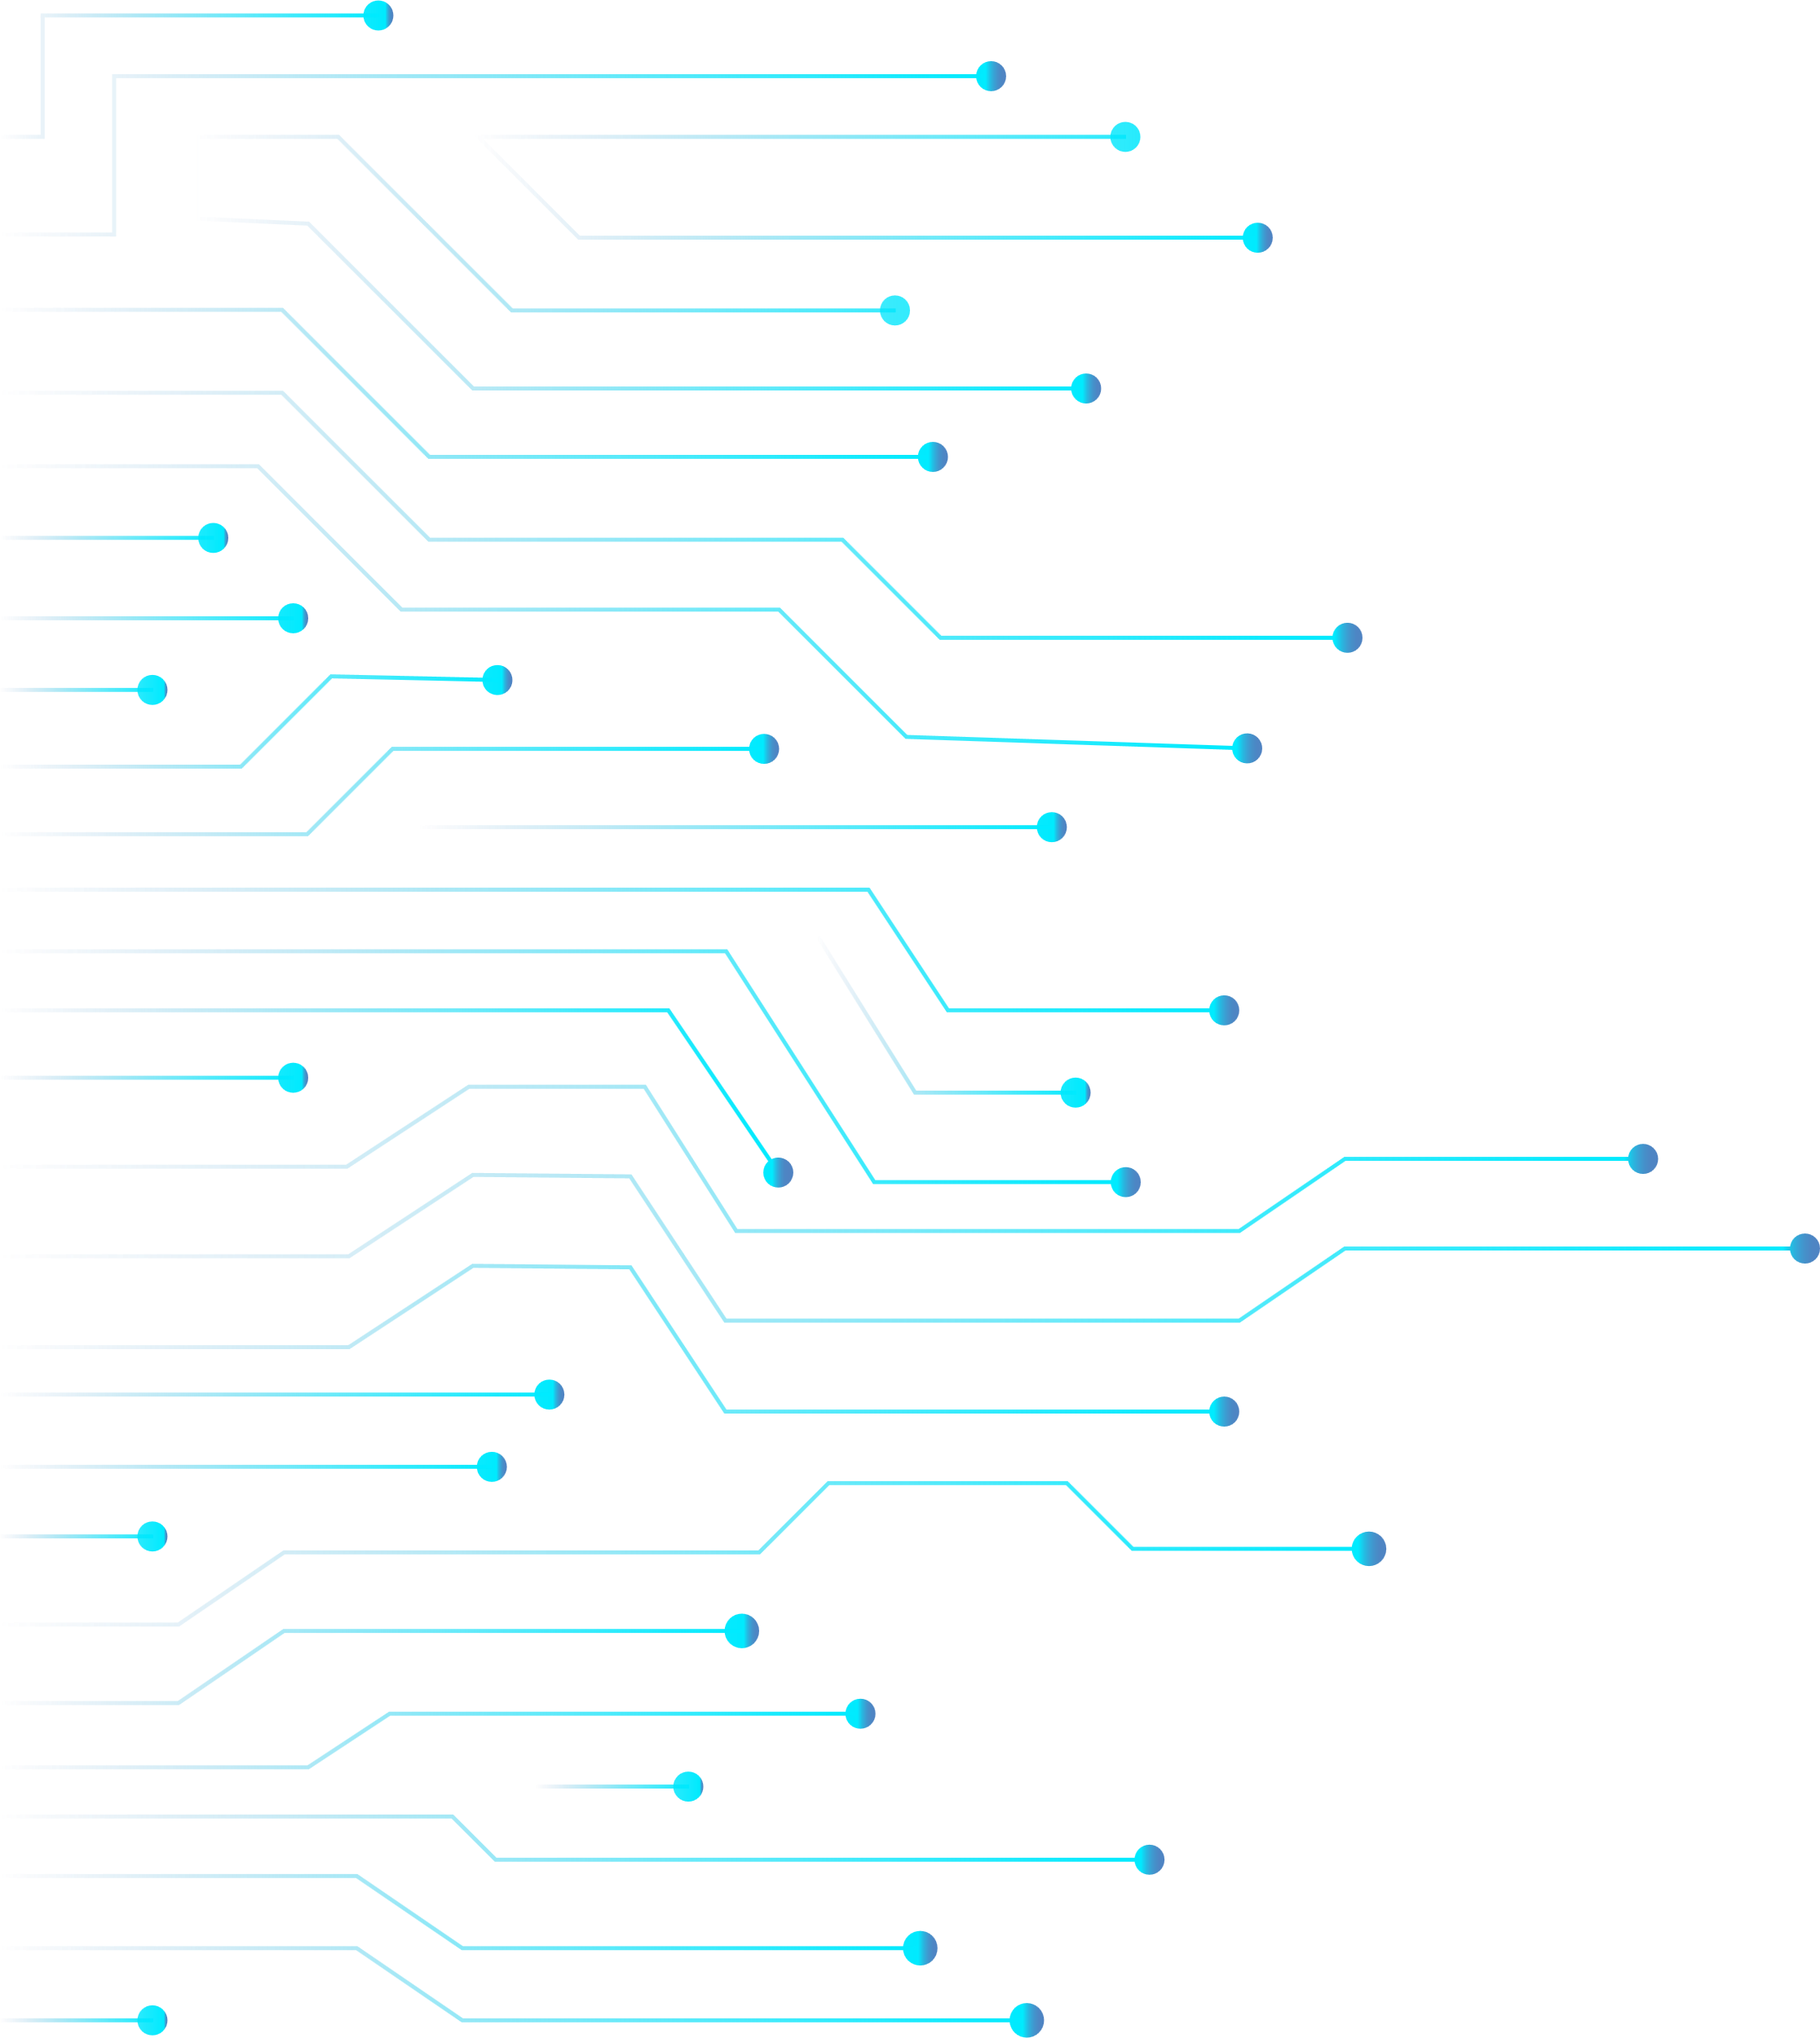

Analyzing Titanic Survival Rates
(classical vs Quantum ML MOdels)
dnsc 6290: QUANTUM computing FOR ANALYTICS
Group 1:
Manuel Jonathan Chavez Carpio
LiWei Huang
Zaheer Soleh
Xilin Yang
Venkata Rithish Sai Reddy Yarasu

Slide 2

Phase I: Classical Machine Learning
1
Data preprocessing and exploration
2
Feature selection and engineering
3
Model training and evaluation

Slide 3
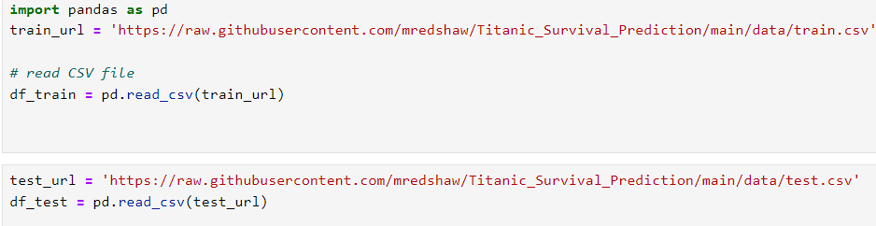
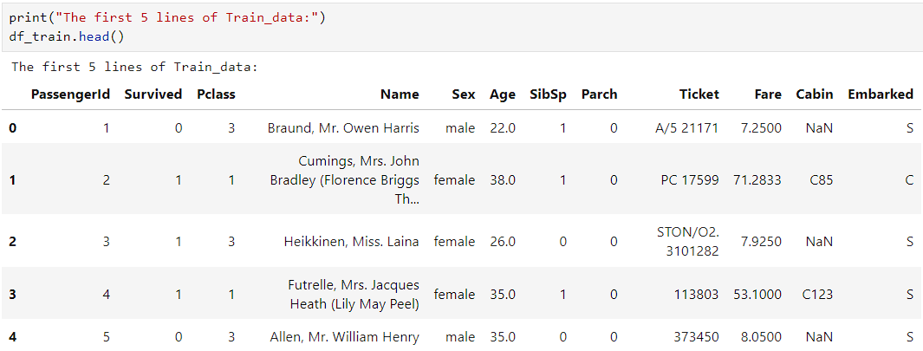
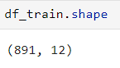
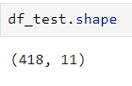
Data preprocessing and exploration

Slide 4
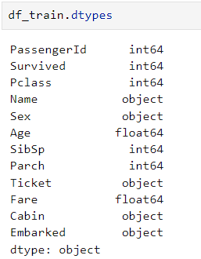
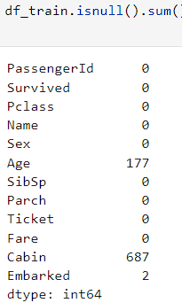
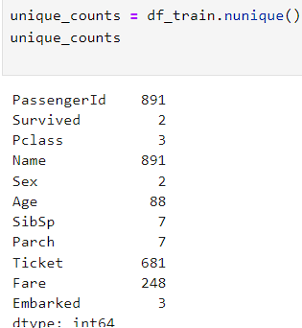
Data preprocessing and exploration
Columns and their data types Null values Check Unique values using nuinque method

Slide 5
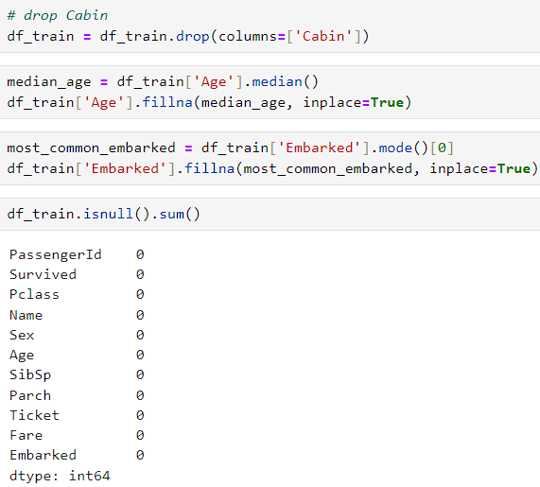
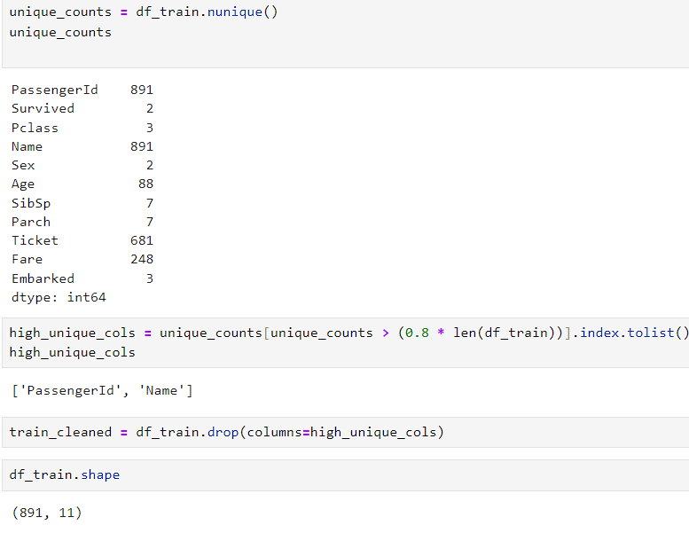
Feature selection and engineering
Cleaning the data by dropping few columns with high null values and unique values (categorical)

Slide 6
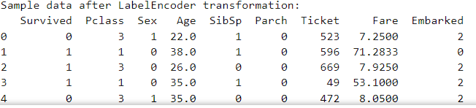
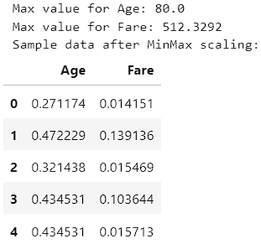
Feature selection and engineering
We have used LabelEncoder() transformer method to convert categorical variables to numerical for our modeling and evaluation.
We have used Min Max Scaler method to normalize Age and Fare values to avoid getting any skewed results.

Slide 7
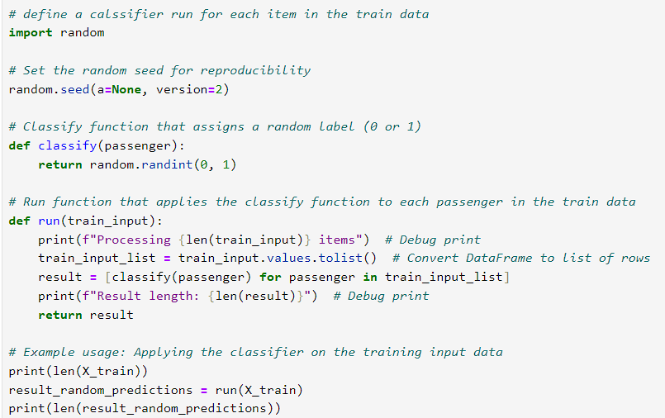
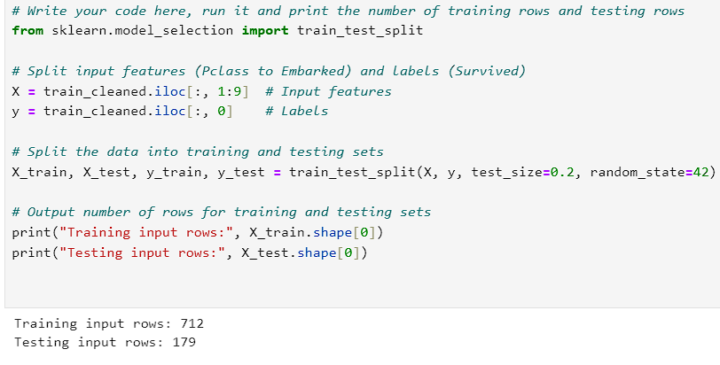
Model training and evaluation

Slide 8
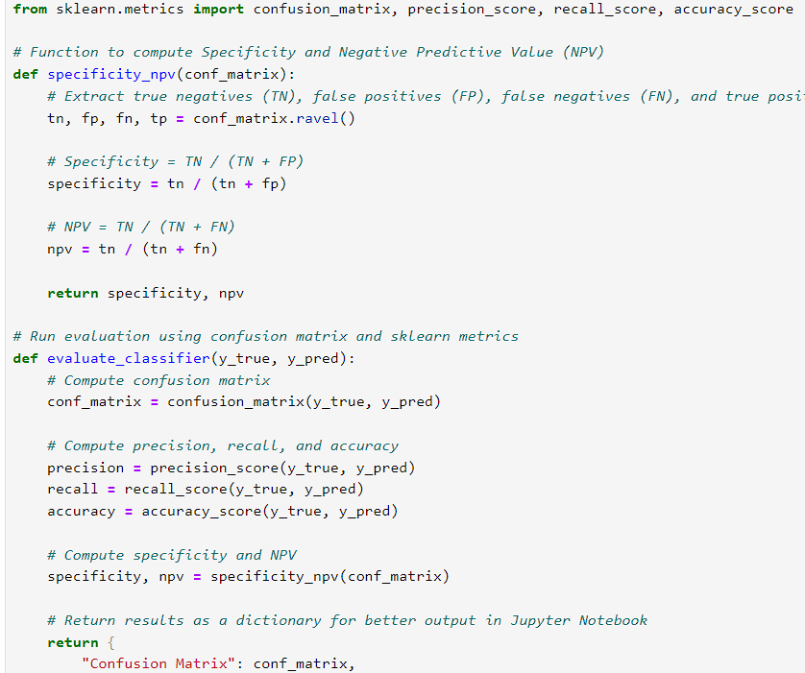
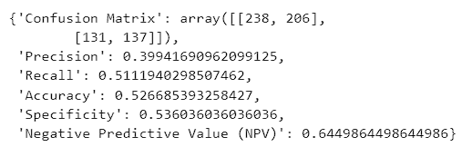
Model training and evaluation
Results

Slide 9

Phase II: Quantum Machine Learning Translation
1
Understanding the basics of quantum computing
2
Translating classical features into quantum features
3
Implementing and testing the quantum model

Slide 10
Approach I:
Custom Variational Circuits & State Vector Counts

Slide 11
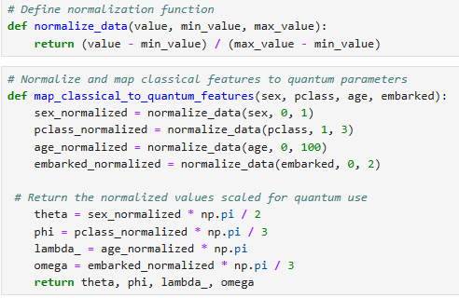
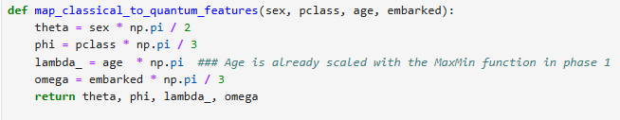
Step 1: Normalization and Feature Mapping
We normalize and convert the classical relevant features (sex,pclass,age and embarked) into quantum gate parameters such as (theta,phi,lambda and omega)

Slide 12
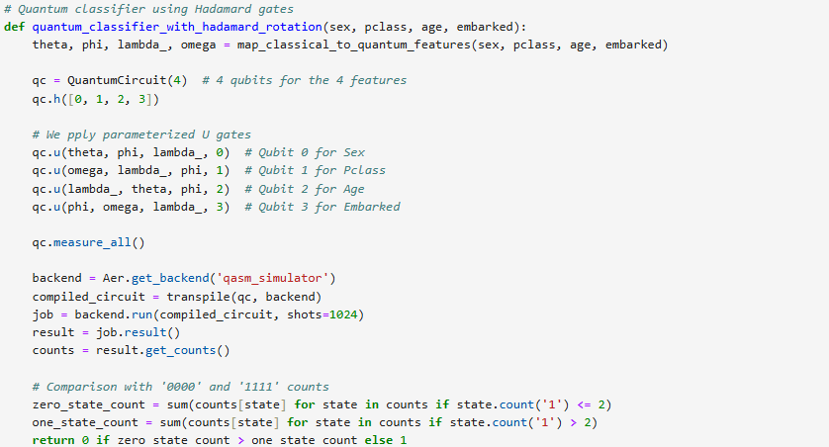
Step 2: Building the Quantum Circuits
Quantum classifier using Hadamard gates
Construction: We create superposition states, we use the U gates based on the parameters selected.
Measurement: After applying the gates and the operations are performed, the measurement counts the frequency of each possible outcome.
Classification decision : Basically the decision making is based on the counting of the output.

Slide 13
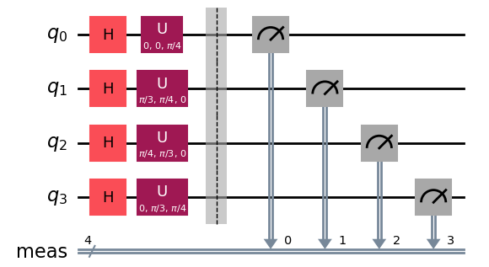
Step 2: Building the Quantum Circuits
Quantum classifier using Hadamard gates

Slide 14
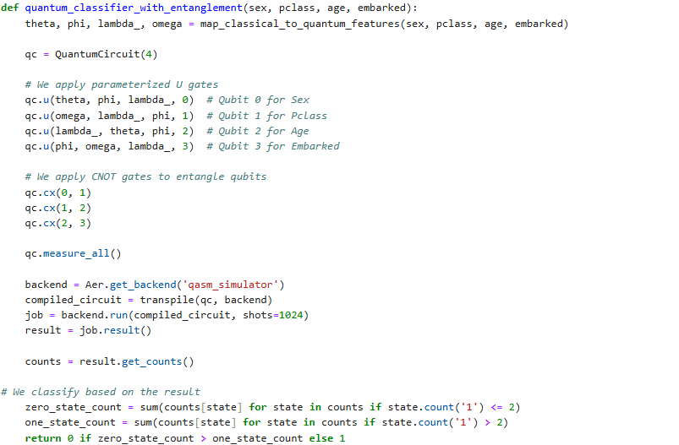
Step 2: Building the Quantum Circuits
Quantum classifier using Entanglement
Construction: We consider ‘n’ number of qubits as features selected , initially we use the U gates encoding the normalized classical features into quantum states.After, we applied the CNOT gates create entanglement among the qubits, this entanglement allow the qubits to be correlated, allowing to discover more complex relationships.
Measurement: After applying the gates and the operations are performed, the measurement counts the frequency of each possible outcome.
Classification decision : Basically the decision making is based on the counting of the output.

Slide 15
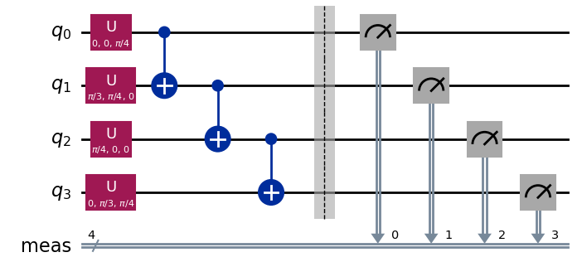
Step 2: Building the Quantum Circuits
Quantum classifier using Hadamard gates

Slide 16
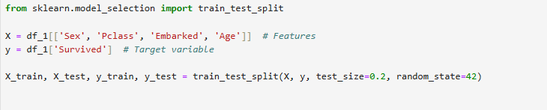
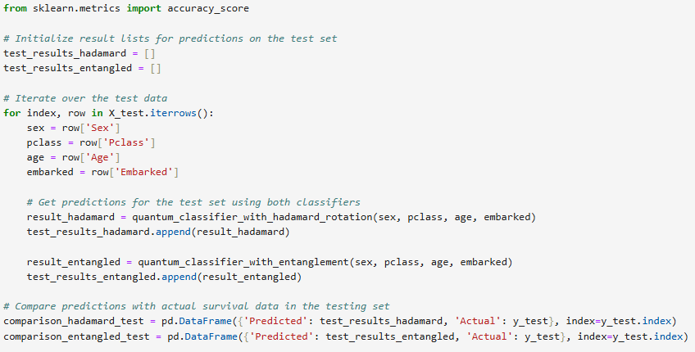
Step 3: Classification
We defined the variables accordingly.
Storage : We create list to store the classification results from both classifiers.
Iteration :We create a loop which iterates over each row of the Dataframe .
Function executing : We execute the classification functions

Slide 17
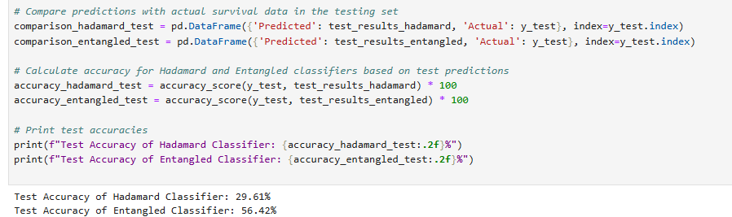
Step 4: Comparison and performance
We create dataframes for a comparison between the predicted values coming from the classifiers and the actual values, coming from the database.
By using the test data, we find the accuracy per each classifier

Slide 18
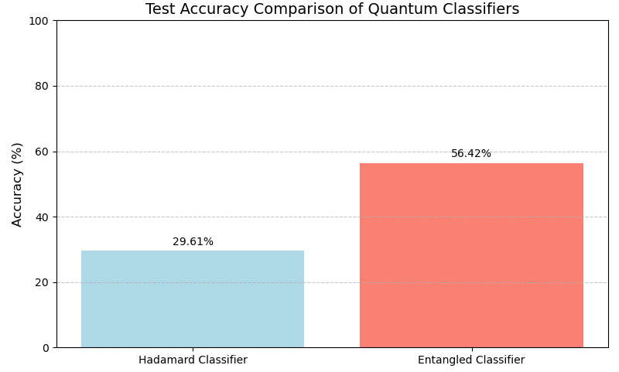
Insights
Parameterization by using the normalization in the features we ensure that the angles are used for rotations within appropriate ranges.
The Entanglement circuit performs a better scenario, could be due to the ability to capture complex relationships between the features, by using the CNOT gate.
Due to the imbalance target, the 56.42% represent a reasonable number, however it can be improved by using naive model.

Slide 19
Approach II:
Quantum Variational Classifier (QVC)
Data Encoding: The ZZFeatureMap transforms classical input data into a quantum state that is encoded onto qubits.
Variational PQCs: The RealAmplitudes ansatz acts as a variational circuit, which takes the encoded state from the feature map and processes it through parameterized gates to classify data points.
Measurement: After applying the parameterized gates and entangling the qubits, the final quantum state is measured.
Training Process: Measure the final quantum state to get probabilities for each class. Calculate the loss based on predictions and true labels. Adjust the parameters of the RealAmplitudes circuit to minimize the loss. For new data, encode it using ZZFeatureMap and run through RealAmplitudes to predict class labels.

Slide 20
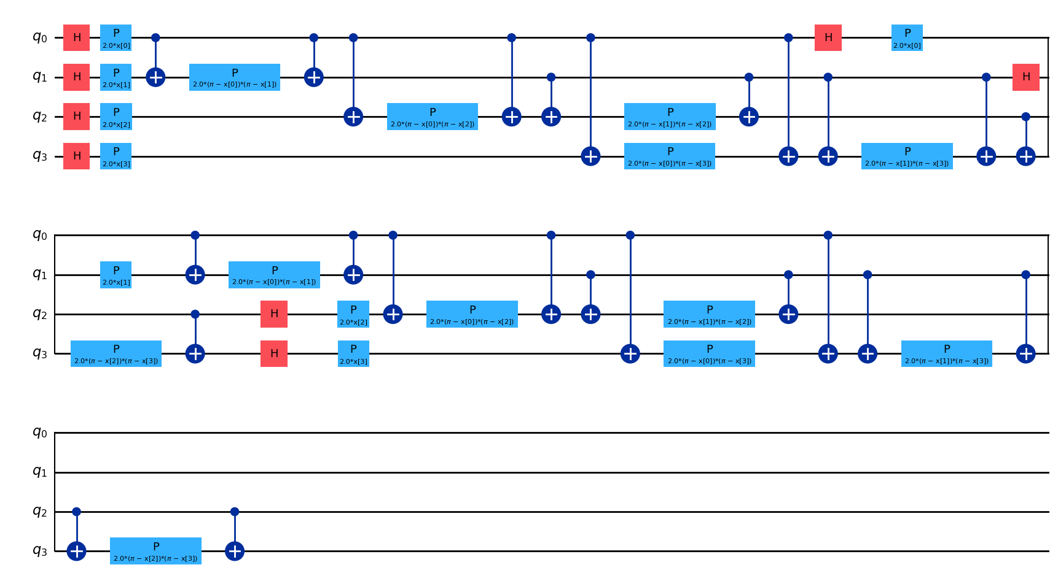
Step 1: Data Encoding with ZZFeatureMap
Initialization: Each qubit starts in the ∣0⟩ state.
Hadamard (H) gates: These are applied to all qubits, creating a superposition.
Phase (P) gates: The phase gates apply rotations based on the feature values These single-qubit gates encode the classical data into the quantum state of each qubit.
Controlled-Z (CZ) gates: Entanglement is introduced between pairs of qubits. encode interactions between features
Final Layer of Gates: The circuit concludes with another set of phase and CZ gates to complete the feature encoding.

Slide 21
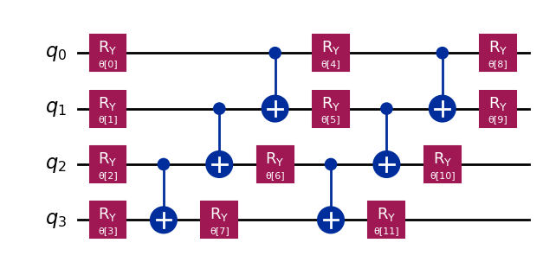
Step 2: Variational Circuit with RealAmplitudes
First Layer of R_y Gates: The first block of Ry​ gates applies a single-parameter rotation to each qubit
First Layer of CNOT Gates: The CNOT gates entangle the qubits, forming connections between neighboring qubits.
Second Layer of R_y Gates: Another layer of Ry follows with new parameters.These adjust the state of the qubits again based on tunable parameters.
Second Layer of CNOT Gates:A second round of CNOT gates adds more entanglement, following a different pattern
Third Layer of R_y Gates: A final layer of RyR_yRy​ gates with parameters applied to the qubits, completing the circuit.

Slide 22
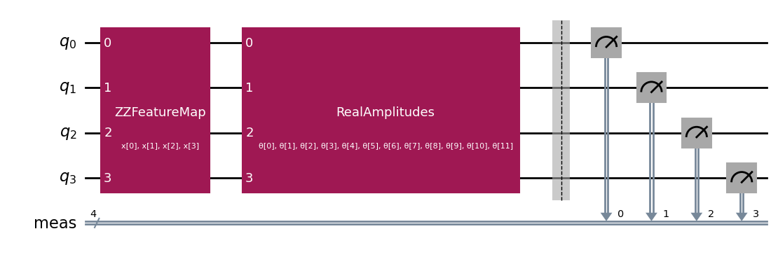
Step 3: Training Process
Measurement: After applying the parameterized gates and entangling the qubits, the final quantum state is measured. The measurement probabilities (obtained from multiple runs) are used to determine the class label (whether the passenger survived or not).
Loss Function: The difference between the measured results and the actual labels is used to compute a loss function, which is minimized by adjusting the parameters of the RealAmplitudes circuit through classical optimization algorithms (SPSA).
Prediction: For new data, encode it using ZZFeatureMap and run through RealAmplitudes to predict class labels.

Slide 23
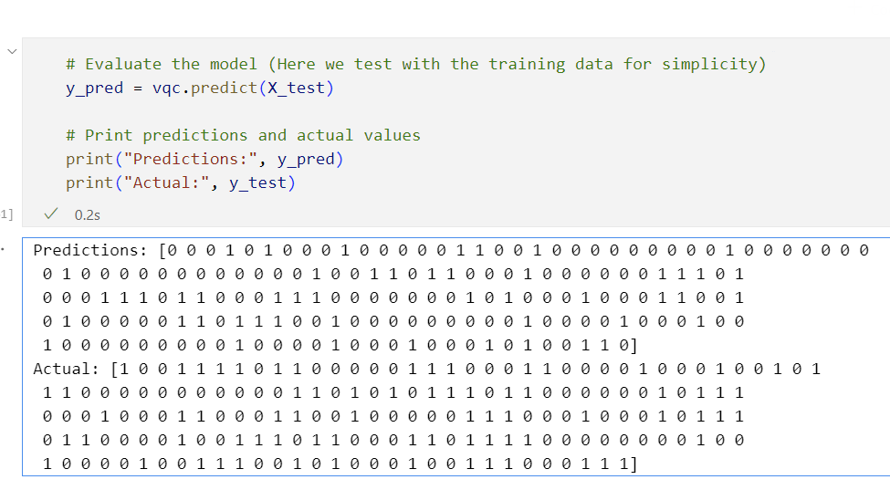
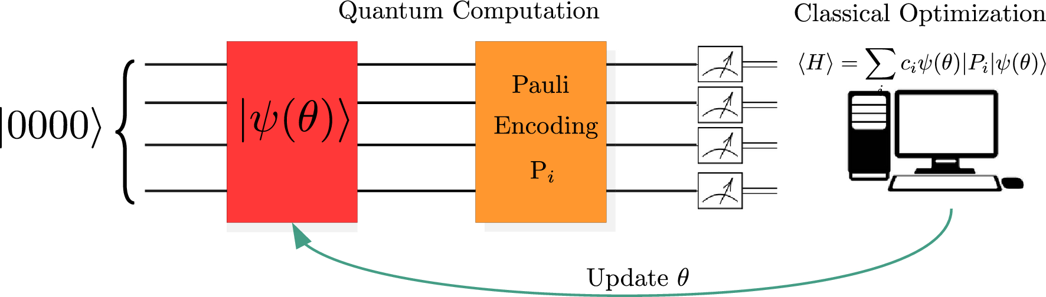
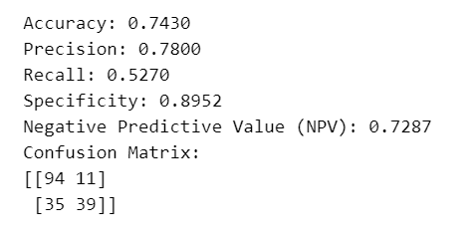
Results
Input Data (Features)
↓
ZZFeatureMap (Encoding)
↓
RealAmplitudes (Variational Circuit)
↓
Measurement (Output Probabilities)
↓
Loss Calculation & Optimization
↓
Class Predictions

Slide 24
Phase III: Naive Bayes in Classical and Quantum Methods
1
Implementing Naive Bayes in a classical setting
2
Translating the Naive Bayes algorithm to a quantum framework
3
Comparing the results and performance of both methods

Slide 25
Implementing Naive Bayes in a Classical Setting

Slide 26
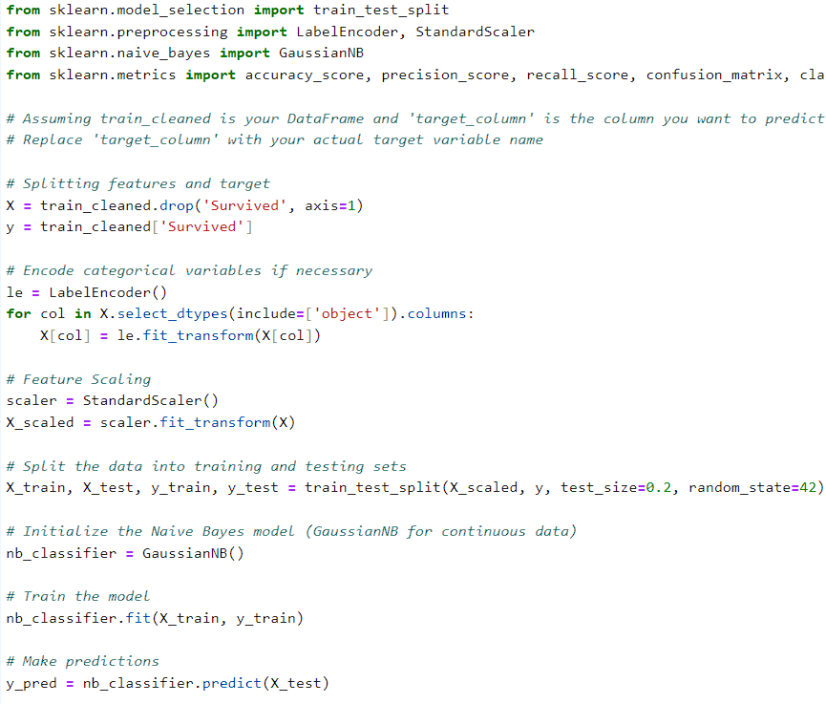
Training the model using Naive Bayes

Slide 27
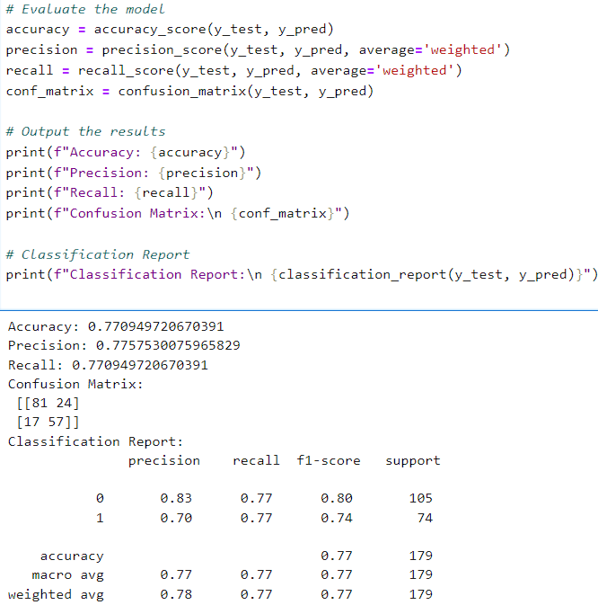
Evaluation and Results

Slide 28
Translating the Naive Bayes algorithm to a quantum framework

Slide 29
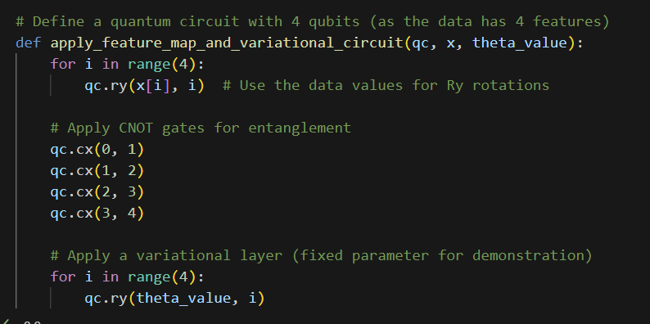
Creating the Mapping and Variational Circuit

Slide 30
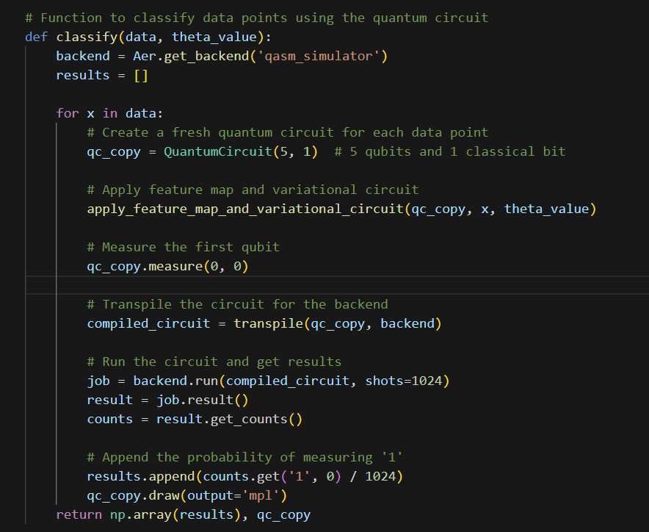
Function to Classify using Measurement and Counts

Slide 31
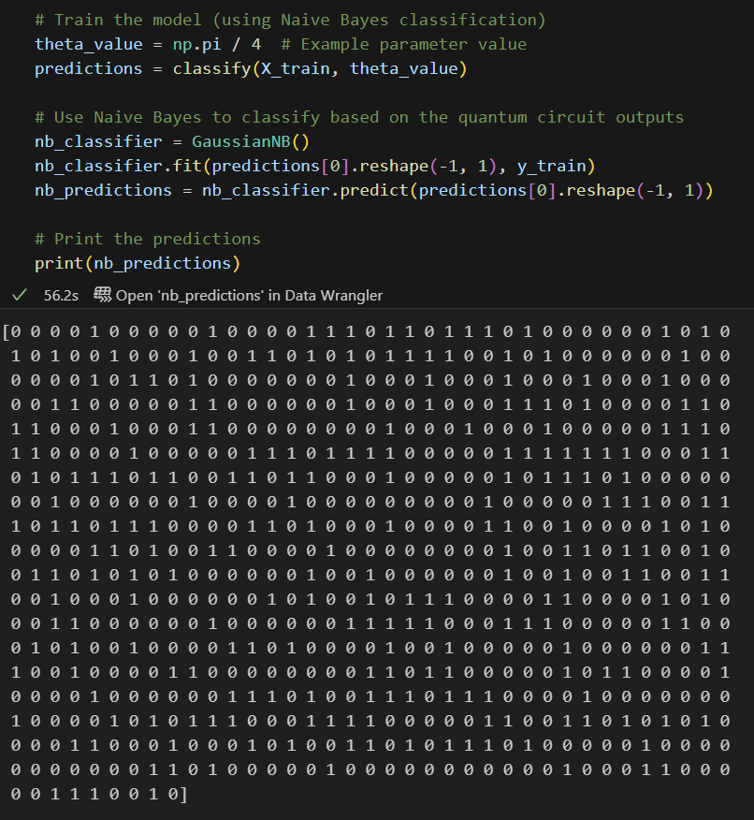
Classifying in Classical Using Quantum Output

Slide 32
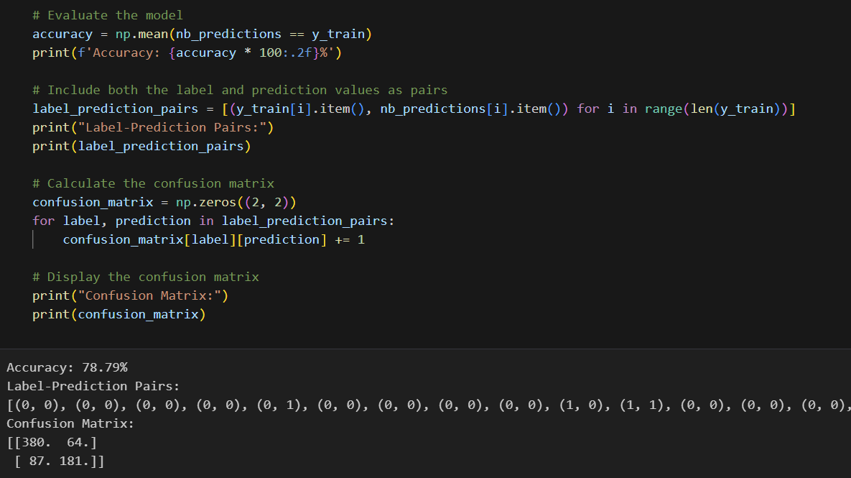
Results

Slide 33
Comparing the results and performance of both methods

Slide 34
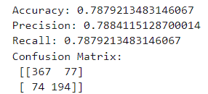
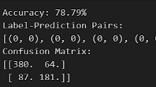
Classical Method | Quantum Method

Slide 35

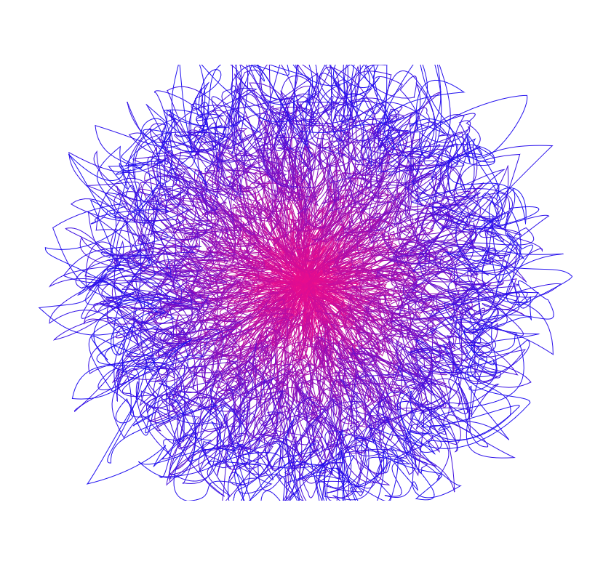

THANK YOU

